Slide 1

Crop Yield prediction in Bangladesh based on machine learning
Mst. Masphy Akter
Roll no: 09-02-17

Slide 2
Outline
Introduction
Literature Review
Methodology
Result and discussion
Conclusion
Reference

Slide 3
INTRODUCTION
Background
Agriculture is a vital element that has a significant role in nourishing the world’s growing population.
To keep pace with the increasing demand for foodstuffs, farmers need to make the best use of them to reap output while minimizing losses.
In recent years, machine learning applications have entered our lives in many areas, from health to defense industries and education to urbanization, and have taken an effective way in decision-making situations.
At the same time, it started to produce information and technology solutions by forming the basis of the newly emerging search engine infrastructure.

Slide 4
Objective
Data Collection and Preprocessing
Exploratory Data Analysis (EDA)
Machine Learning Model Development
Model Evaluation
Feature Importance Analysis
Model Deployment and Testing

Slide 5
Literature Review
In its earliest, many analyses and models were being done for estimating the negative and positive effect of climate on various types of crops in Bangladesh and different nations.
Aruvansh Nigam, Saksham Garg, Archit Agrawal, Parul Agrawal investigates Indian government dataset and it's been laid out that Arbitrary Timberland AI the calculation gives the best yield expectation precision.
E Setiawati and W A Yusuf is gaining practical experience in the exactness and strength and relationship of irregular woods calculations.
Anakha Venugopal, Aparna S, Jinsu Mani, Rima Mathew, Prof. Vinu Williams has hypothetically portrayed different machine learning strategies that can be applied in different gauging regions.

Slide 6
Methodology
Data Collection
Dataset Description
Data Processing (Data cleaning, Data Encoding, Dataset Splitting)
Apply Machine Learning Model (Linear Regression, Random Forest Regression, Decision Tree Regression)

Slide 7
RESULT AND DISCUSSION
Pre-processing Result
As there was no null values or missing values, we dropped down irreverent columns, Then we directly distlplot the dataset. It is represented that pesticides have a high effect on yield.

Slide 8
Correlation Metrics
We visualize the correlation relation among features are given below. The diagram shows negative relation between high annual rainfall and yield, that means heavy rainfall decreases amount of yield. Conversely fertilizer and pesticide value are positively increasing the yield production.

Slide 9
Result Analysis for Machine Learning Model
We split the data into training and testing dataset. We applied different machine learning models to count mean squared error and R-squared error.
Table 4.1: MSE and r2 Score of different models
Mean Squared Error of Linear Regression | 0.4619998281981817
R-sequared Score of Linear Regression | 34.44396381863817
Mean Squared Error of Random Forest | 0.039132642904837325
R-sequared Score of Random Forest | 94.44722530710257
Mean Squared Error of Decision tree | 0.045749528640184216
R-sequared Score of Decision tree | 93.50831413398355

Slide 10
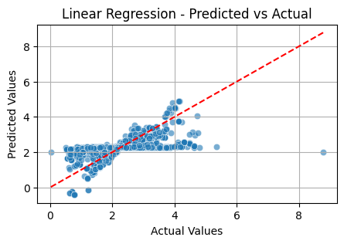
For Linear Regression:
Mean Squared Error of Linear Regression: 0.4619998281981817
R-sequared Score of Linear Regression: 34.44396381863817

Slide 11
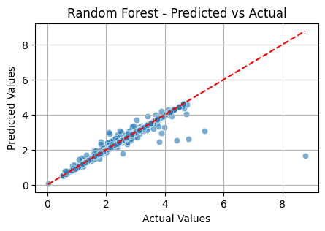
For Random Forest:
Mean Squared Error of Random Forest: 0.039132642904837325
R-sequared Score of Random Forest : 94.44722530710257

Slide 12
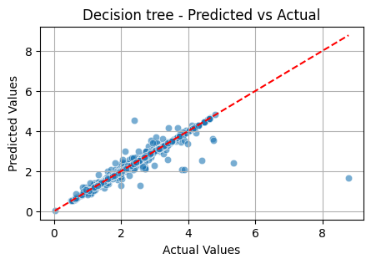
For Decision Tree:
Mean Squared Error of Decision tree: 0.04556063726213749
R-sequared Score of Decision tree : 93.535117109348

Slide 13
Features Importance
Different features have different importance to crop prediction. The ration of different models is following below the table.
Table 4.2: Features importance
Feature | Importance (%)
Production | 46.75
Area | 46.66
Fertilizer | 4.64
Pesticide | 0.99
Annual Rainfall | 0.95

Slide 14
Algorithm Result
These are the different Machine learning regression algorithms used in this particular research. Out of those 3 models we can fix a best model for the deployment of the model.
Table 4.3: Algorithm Result
Model | R2 Score
Linear Regression | 34.44
Random Forest | 94.45
Decision tree | 93.69

Slide 15
Conclusion
The demand and supply for food have grown more difficult to manage as the population grows. To assist farmers, experts have worked hard over the past few years to anticipate agricultural yield production. In order to forecast crop yield, this study uses various machine learning and deep learning approaches. The study underlines the advantages of cutting-edge procedures. We apply three machine learning and deep learning algorithms, Decision Tree, Random Forest to the dataset taken into consideration. When data is analyzed at the country level, Random Forest Regression and Decision Tree Regression perform better. To increase the model’s accuracy in crop production prediction, remote sensing data could be amalgamated with statistical data of districts.

Slide 16
Reference
[1] Nigam, A., Garg, S., Agrawal, A. and Agrawal, P., 2019, November. Crop yield prediction using machine learning algorithms. In 2019 Fifth International Conference on Image Information Processing (ICIIP) (pp. 125-130). IEEE.
[2] Crane-Droesch, A., 2018. Machine learning methods for crop yield prediction and climate change impact assessment agriculture. Environmental Research Letters, 13(11), p.114003. in
[3] Van Klompenburg, T., Kassahun, A. and Catal, C., 2020. Crop yield prediction using machine learning: A systematic literature review. Computers and Electronics in Agriculture, 177, p.105709.
[4] Sellam, V., and E. Poovammal. "Prediction of crop yield using regression analysis." Indian Journal of Science and Technology 9.38 (2016): 1-5.
[5] Hegde, Niranjan G., et al. "Survey paper on agriculture yield prediction tool using machine learning." Int. J 5 (2017): 36-39.
[6] Priya, P., U. Muthaiah, and M. Balamurugan "Predicting yield of the crop using machine learning algorithm." International Journal of Engineering Sciences & Research Technology 7.1 (2018): 1-7.
[7] Hassan, Fazal Mahmud, et al. Agricultural yield and profit prediction using data analysis techniques. Diss.2018.
[8] Sivanand, K., M. Sai Amrutha, and J. Chaitra Nayak. "Web Application Development for Site Specific Crop Prediction using Machine Learning." International Journal of Modern Agriculture 10.2 (2021): 3538-3549.

Slide 17


